Slide 1


Taller de SQL
Introducción a las bases de datos relacionales
Martes, 03 de marzo de 2020
18:00 – 20:00

Slide 2
Índice
1 – ¿Qué son las bases de datos?
2 – ¿Por qué SQL?
3 – Comandos de creación y destrucción
4 – Comandos de inserción y alteración
5 – Comandos de peticionamiento
6 – Uso de una base de datos

Slide 3

La pregunta no es "¿qué queremos saber de la gente?", sino "¿qué desea contarnos la gente de sí misma?"
Mark Zuckerberg

Slide 4
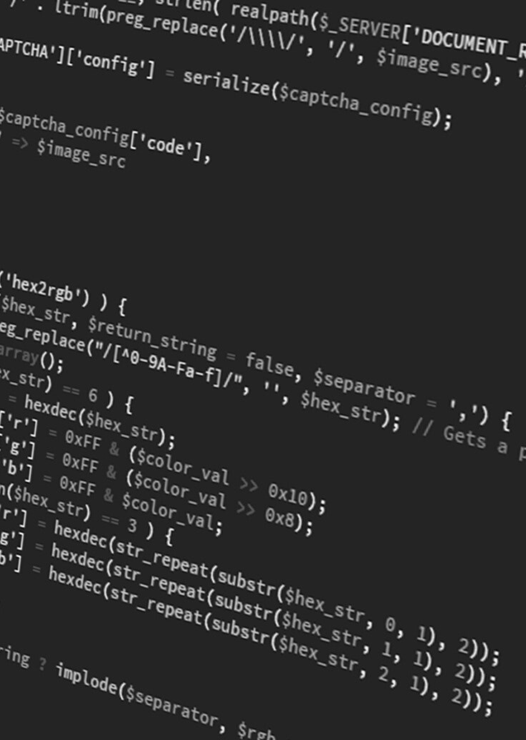

About Reel Engine Studios
Presentations are communication tools that can be used as demonstrations.

Slide 5
VIDEOGRAPHY
Presentations are communication tools that can be used as demonstrations.
ANIMATION
Services
Presentations are communication tools that can be used as demonstrations.
BRAND STRATEGY
Presentations are communication tools that can be used as demonstrations.

Slide 6


Presentations are communication tools that can be used as demonstrations.Presentations are communication tools that can be used as demonstrations.Presentations are communication tools that can be used as demonstrations.Presentations are communication tools that can be used as demonstrations.

Slide 7
What was the biggest digital trend last year?
VIDEO MARKETING.

Slide 8
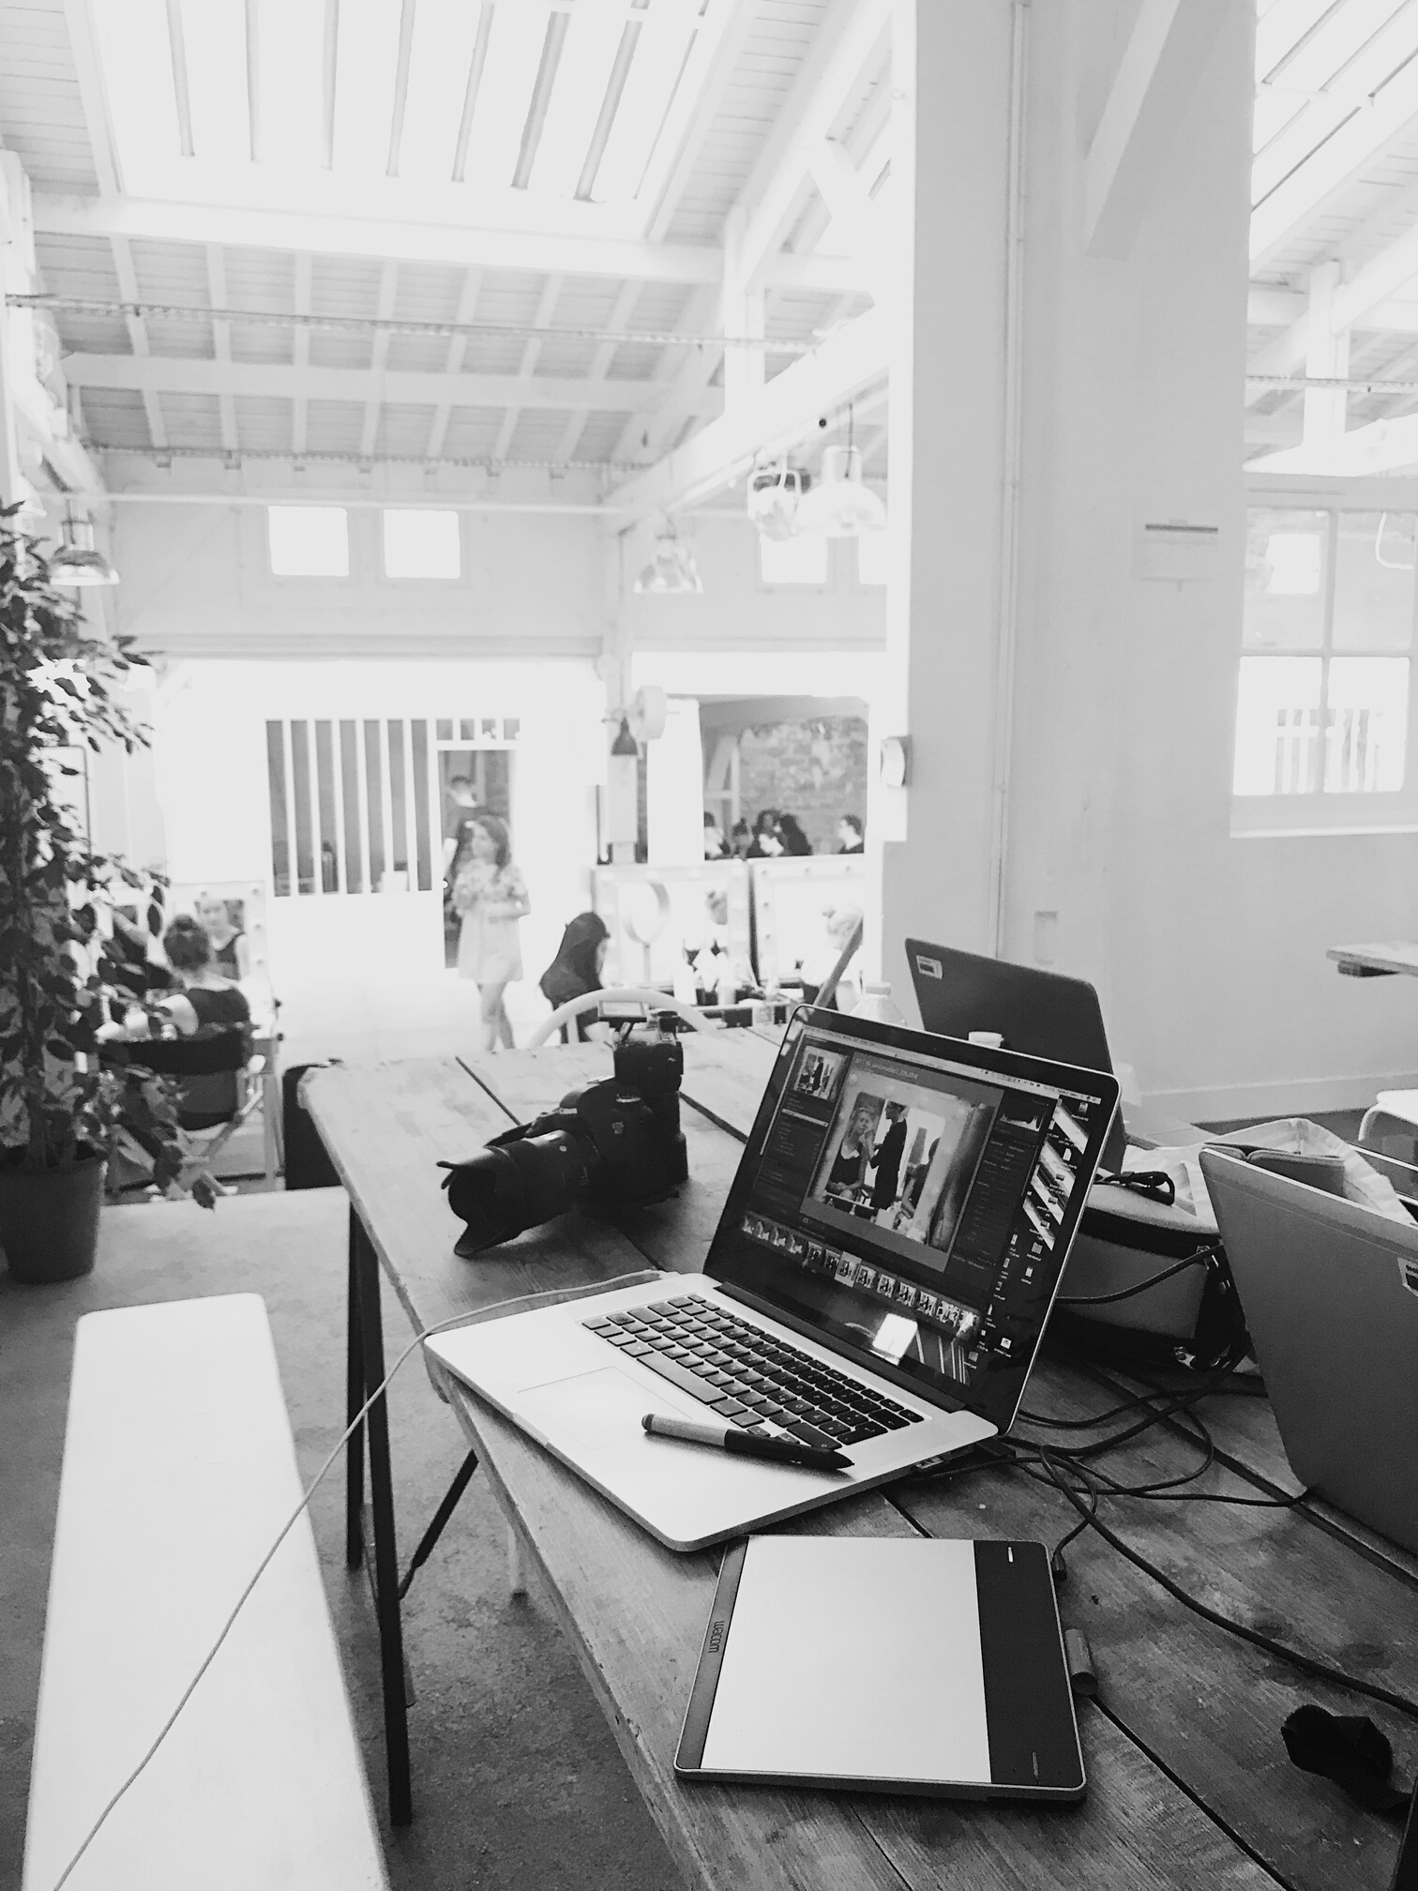

Presentations are communication tools that can be used as lectures.
ENGAGEMENT WITHOUT VIDEO
Presentations are communication tools that can be used as lectures.
ENGAGEMENT WITH VIDEOS

Slide 9

Presentations are communication tools that can be used as demonstrations.
Sample Campaign

Slide 10
Video Types
Item 5
20%
Item 1
20%
BY POPULARITY
Item 4
20%
Item 2
20%
Item 3
20%
Presentations are communication tools that can be used as demonstrations.

Slide 11
The Approach
CONNECTING BRANDS AND CUSTOMERS
Presentations are communication tools that can be used as demonstrations.

Slide 12




Connect With Us

Slide 13
Why Video for Advertising?
ENGAGING
STICKY
Presentations are communication tools that can be used as lectures.
Presentations are communication tools that can be used as lectures.
CUSTOMIZABLE
OPTIMIZABLE
Presentations are communication tools that can be used as lectures.
Presentations are communication tools that can be used as lectures.

Slide 14
80%
OF INTERNET TRAFFIC IS VIDEO
Presentations are communication tools that can be used as lectures.

Slide 15
Looking Ahead
MARKETERS' PREDICTIONS
Presentations are communication tools that can be used as demonstrations.

Slide 16


What Makes a Good Advertising Video?
Story-Centric
Unique
Mobile-Friendly

Slide 17



Testimonios
JOSHUA BIRCH
BAHIJ MALDO
TOM AWOSIKA
Restaurant Owner
Designer
Content Strategist
Presentations are communication tools.
Presentations are communication tools.
Presentations are communication tools.

Slide 18
Impact
BENEFITS FOR YOUR BRAND
BOOSTS TRAFFIC
Presentations are communication tools that can be used as demonstrations.
Presentations are communication tools that can be used as demonstrations.
INCREASES CONVERSIONS
INFORMS CUSTOMERS
Presentations are communication tools that can be used as demonstrations.
Presentations are communication tools that can be used as demonstrations.

Slide 19


REEL ENGINE STUDIOS IN 2020
Presentations are communication tools that
can be used as lectures.

Slide 20


Behind the Scenes
Presentations are communication tools that can be used as lectures.

Slide 21
The Process
BRAND STUDY
Presentations are communication
tools that can be used as lectures.
PROPOSAL
Presentations are communication
tools that can be used as lectures.
INITIAL VIDEO
Presentations are communication
tools that can be used as lectures.

Slide 22



RELEASE
Presentations are communication tools.
MONITORING
Next Steps
Presentations are communication tools.
ANALYSIS
Presentations are communication tools.

Slide 23


Testimo-nios
LALITHA MYERS
ANA CARTAYA
ROSS LOREY

Slide 24
ADDRESS
Paseo de Recoletos 15
EMAIL ADDRESS
Acelera tu carrera digital
admisiones@thebridge.tech

